Slide 1

503073
WEB PROGRAMMING & APPLICATIONS
LESSON 3: CASCADING STYLE SHEETS
Notes:
Tutorials:
Tables
Block vs Inline, Box model

Slide 2
Introduction to CSS
CSS stands for Cascading Style Sheets
CSS describes how HTML elements are to be displayed on screen, paper, or in other media.
CSS saves a lot of work. It can control the layout of multiple web pages all at once.
External stylesheets are stored in *.css files.

Slide 3
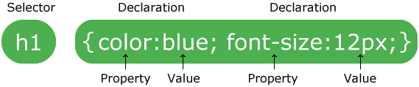
CSS Syntax
A CSS rule-set consists of a selector and a declaration block.
The selector points to the HTML element you want to style.
The declaration block contains one or more declarations separated by semicolons.

Slide 4
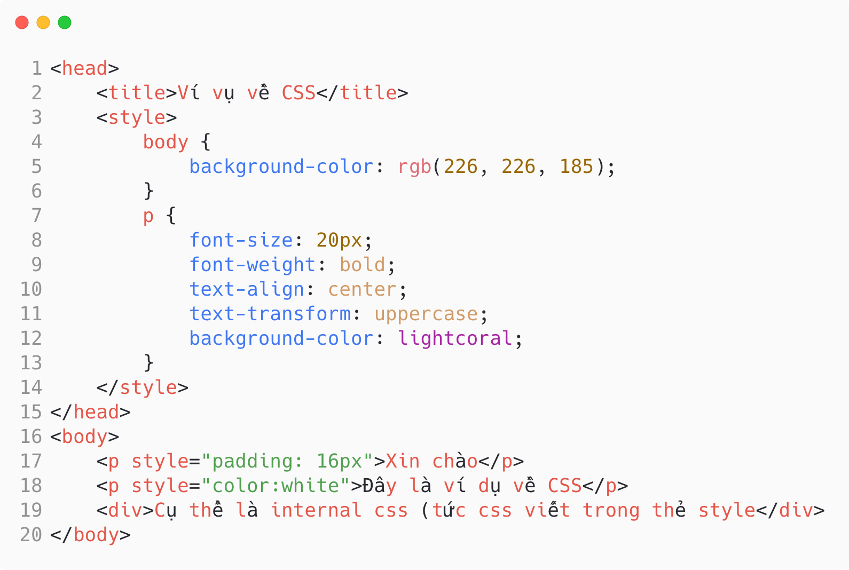

Slide 5
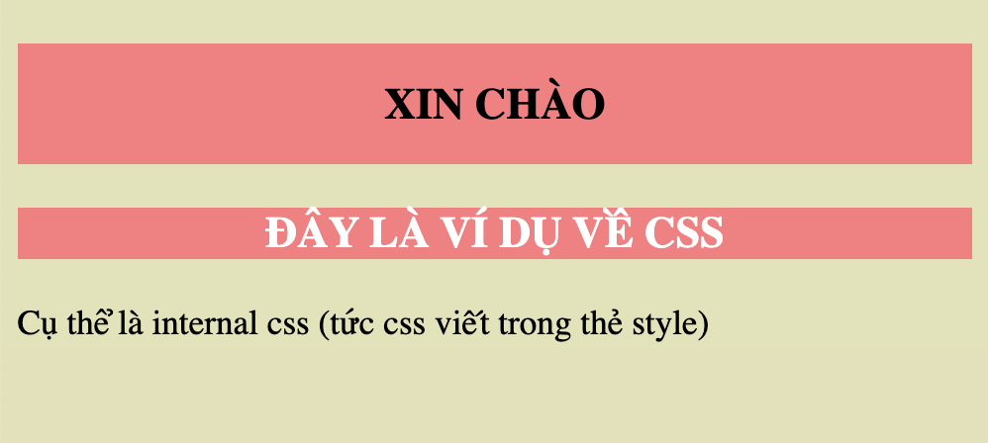

Slide 6
Three Ways to Insert CSS
External CSS
Internal CSS
Inline CSS

Slide 7
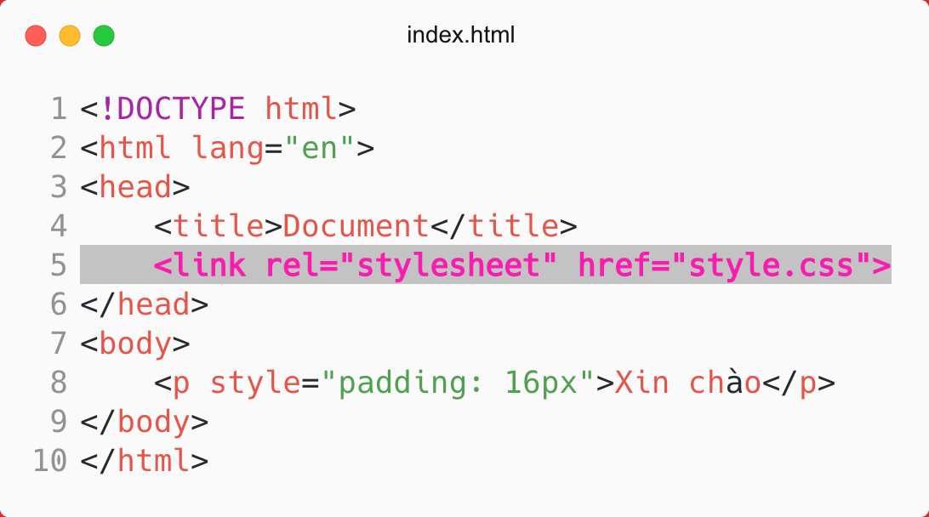
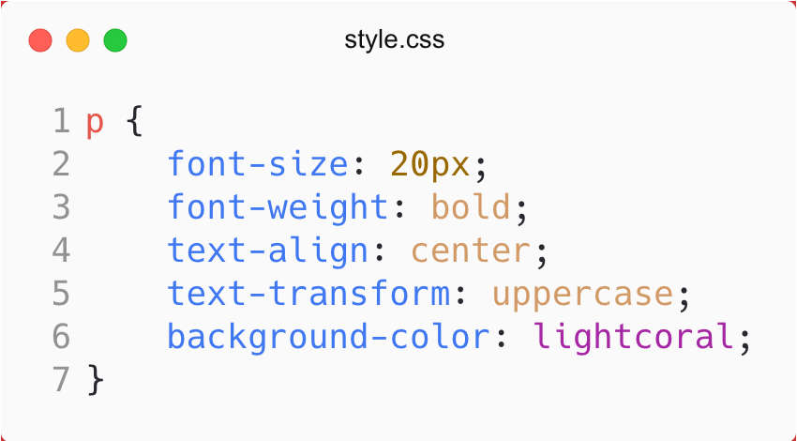
External CSS

Slide 8
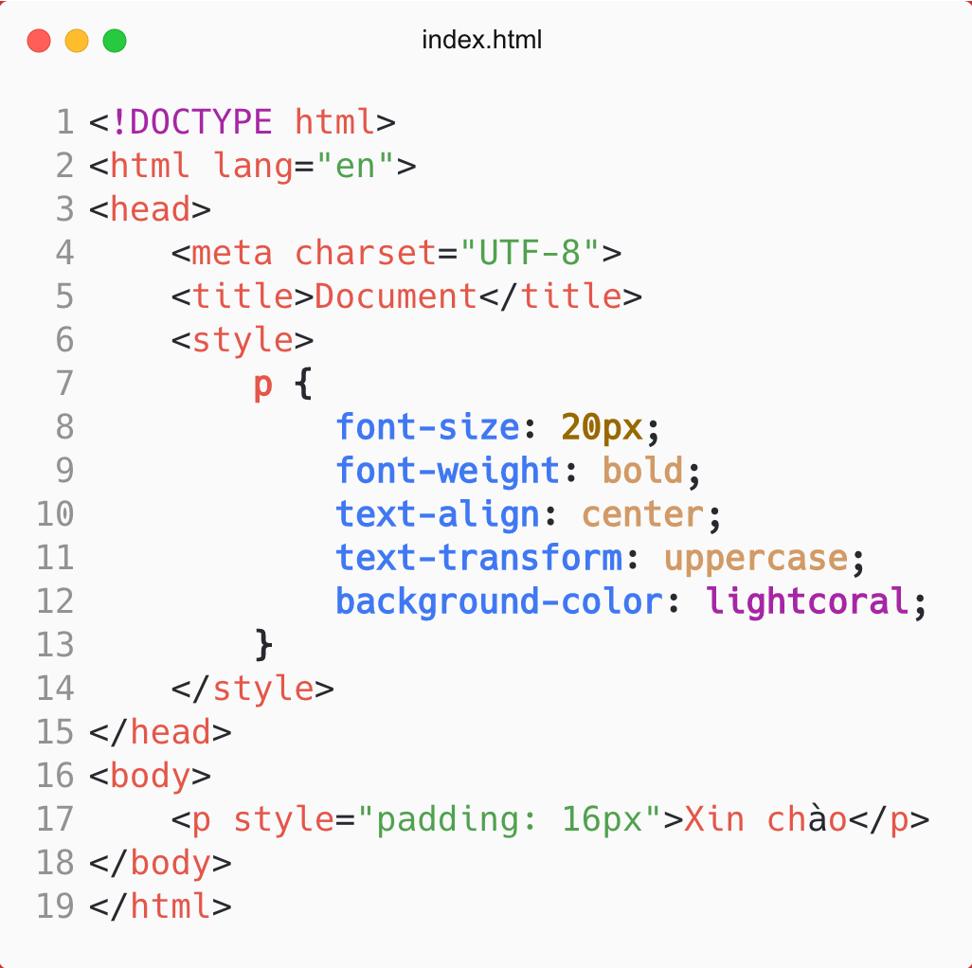
Internal CSS

Slide 9
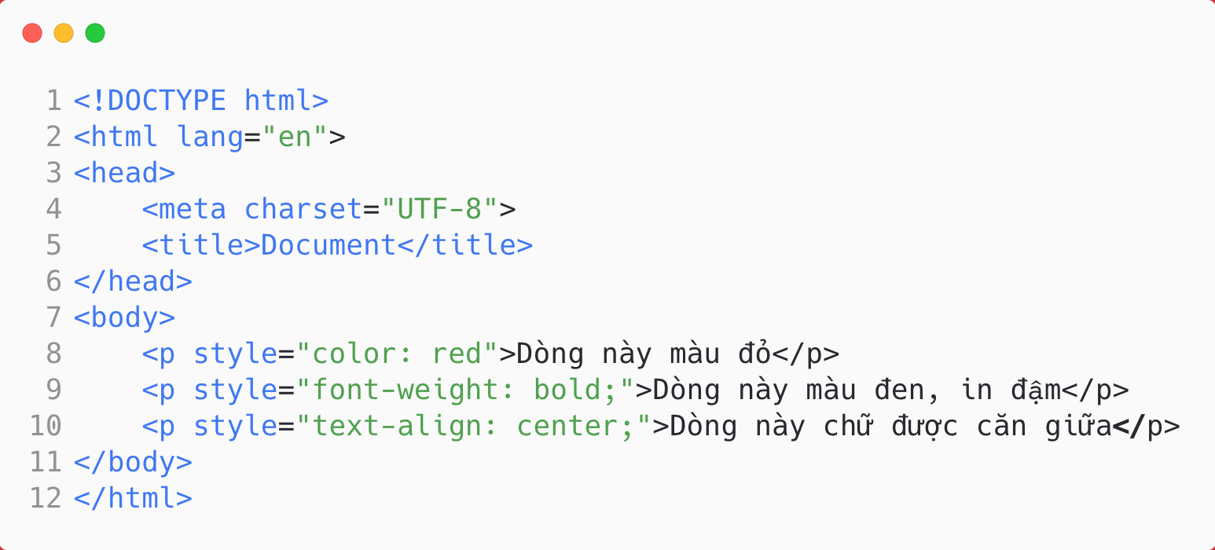
Inline CSS

Slide 10
CSS Priority
Important CSS
Inline style (inside an HTML element)
External and internal style sheets (in the head section)
Browser default

Slide 11
CSS Selectors
We can divide CSS selectors into five categories:
Simple selectors: select elements based on name, id, class
Combinator selectors: based on a specific relationship between tags.
Pseudo-class selectors: based on a certain state
Pseudo-elements selectors: select and style a part of an element
Attribute selectors: based on an attribute or attribute value

Slide 12
SIMPLE SELECTORS

Slide 13
Simple Selectors
Name selector
Id Selector
Class selector

Slide 14
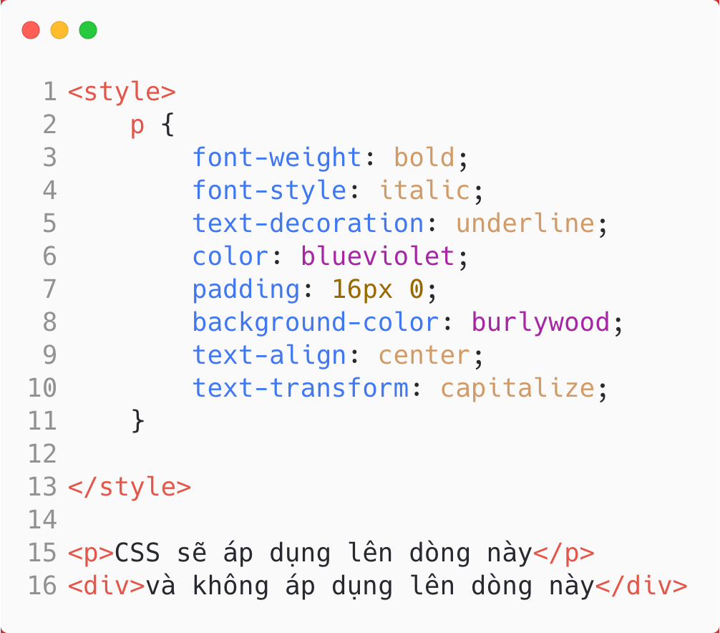
Name Selectors

Slide 15
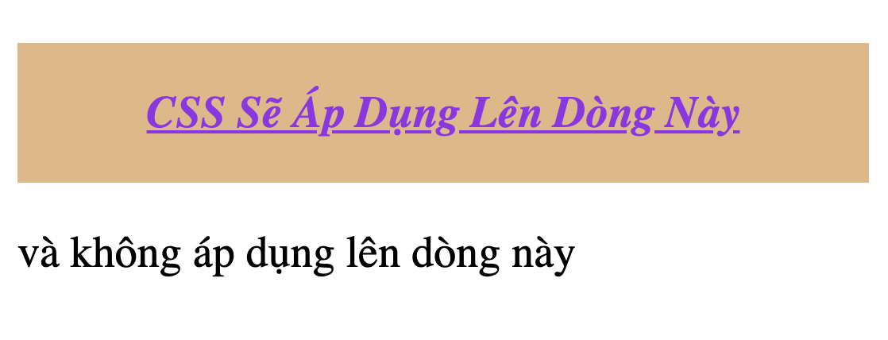
Name Selectors

Slide 16
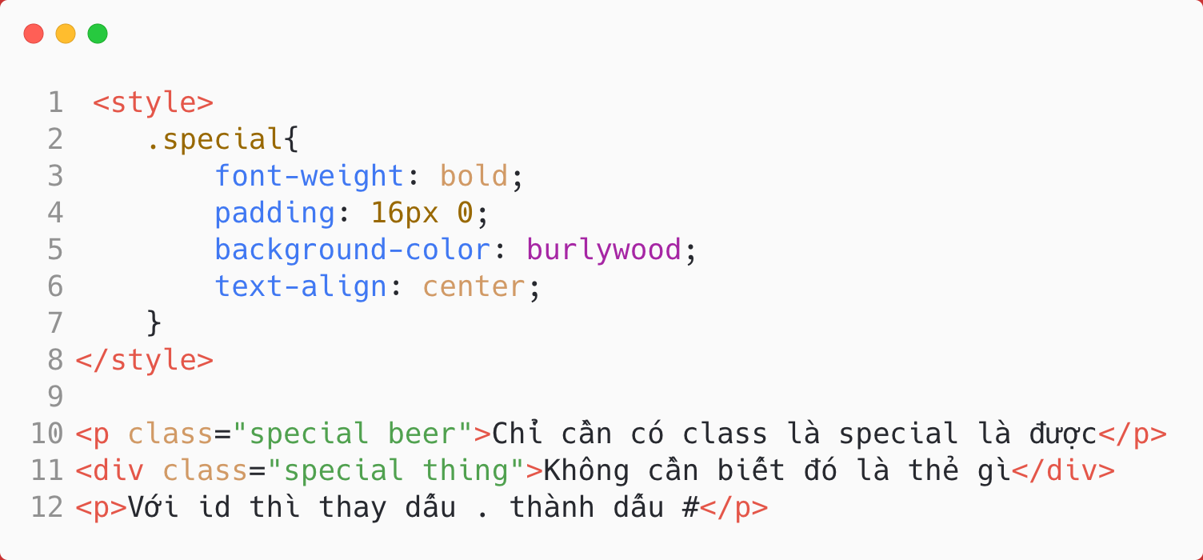
Id & Class Selectors

Slide 17
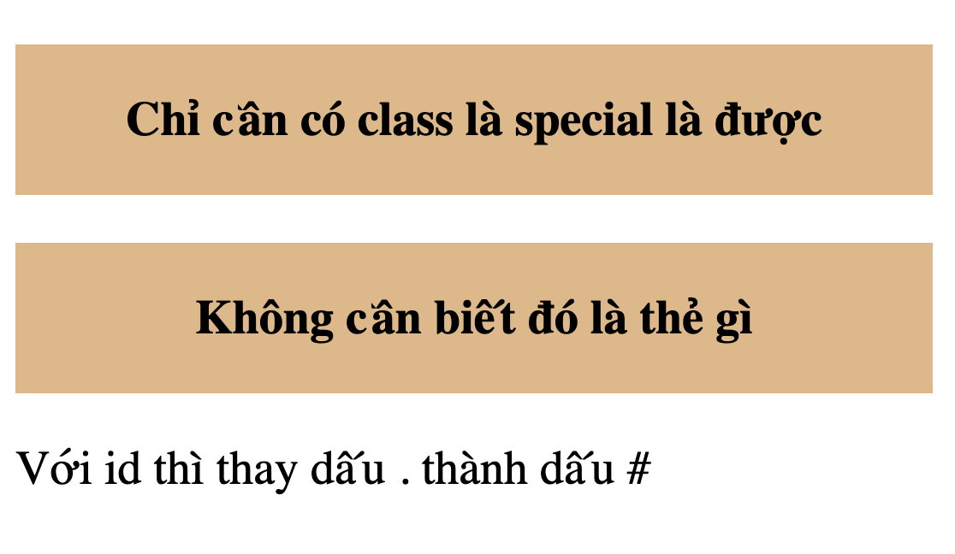
Id & Class Selectors

Slide 18
COMBINATOR SELECTORS

Slide 19
Combinator Selectors
Descendant selector (space)
Child selector (>)
Adjacent sibling selector (+)
General sibling selector (~)

Slide 20
PSEUDO-CLASS SELECTORS

Slide 21
Pseudo-class Selectors
A pseudo-class is used to define a special state of an element.
Examples:
Anchor Pseudo-classes: a:link, a:visited, a:active
:hover
:first-child, :last-child
:checked, :empty, :disabled, :focus, :invalid
:nth-child(n), :last-of-type, :not(selector)
https://www.w3schools.com/css/css_pseudo_classes.asp

Slide 22
CSS PSEUDO-ELEMENTS

Slide 23
CSS Pseudo-elements
A CSS pseudo-element is used to style specified parts of an element.
For example, it can be used to:
Style the first letter, or line, of an element
Insert content before, or after, the content of an element.

Slide 24
CSS Pseudo-elements
::first-line
::first-letter
::before
::after
::selection

Slide 25
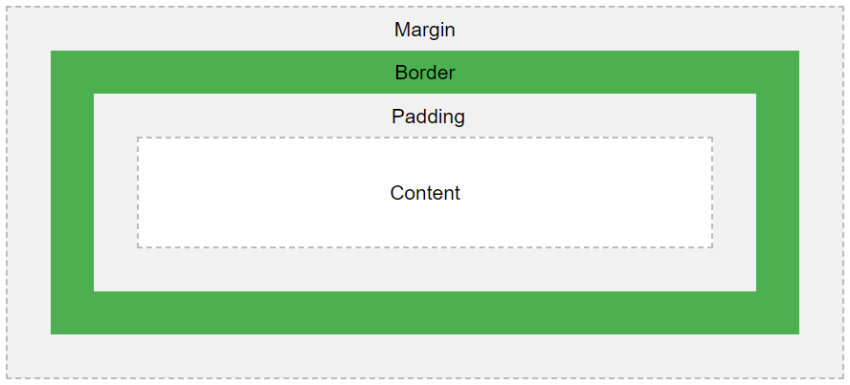
Box Model
All HTML elements can be considered as boxes.
It consists of: margins, borders, padding, and the actual content.

Slide 26
Box Model: Width and Height
By default:
When you set the width and height properties of an element with CSS, you just set the width and height of the content area.
To calculate the full size of an element, you must also add padding, and borders.
(by default)
Width = Content width
Width = Content width + padding + border

Slide 27
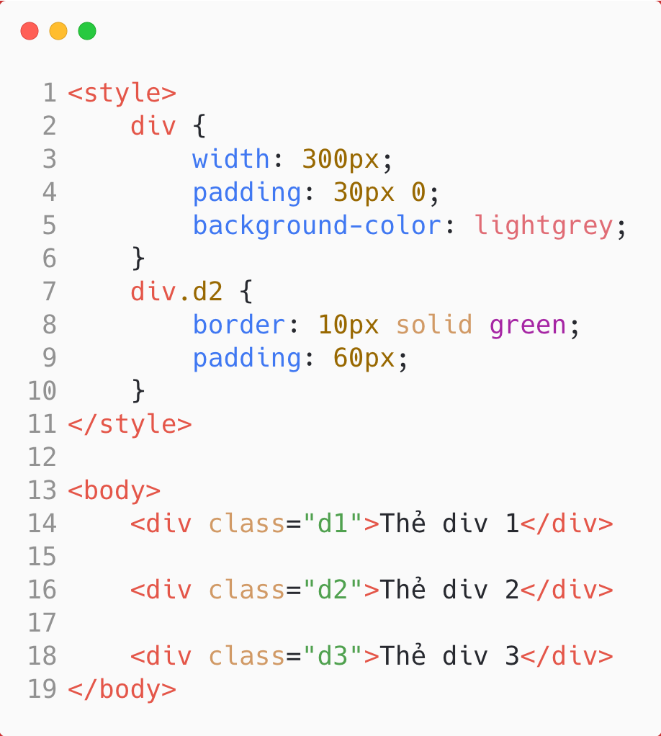
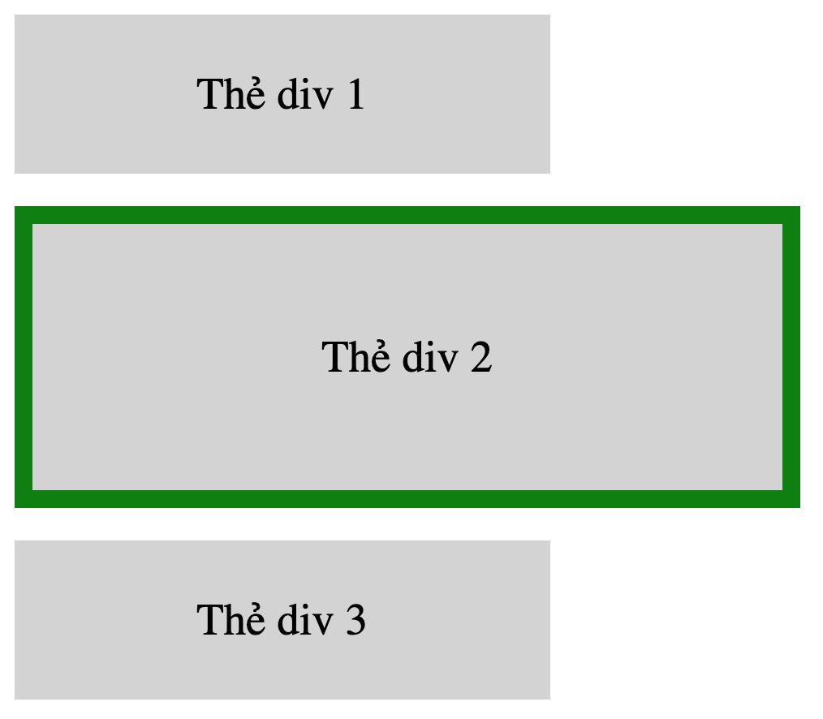

Slide 28
Box Model: Box sizing
Setting the css box-sizing property to border-box makes sure that the padding and border are included in the total width and height of the elements.
(box-sizing: border-box)
Width = Content width
Width = Content width + padding + border

Slide 29
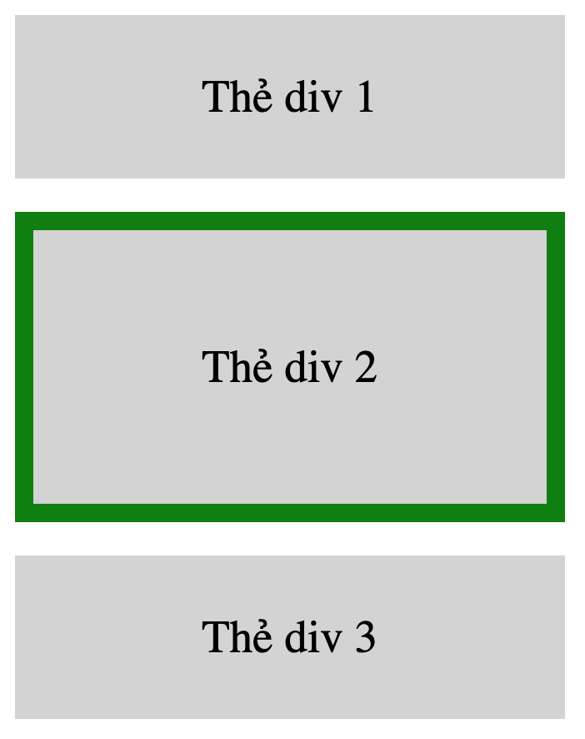
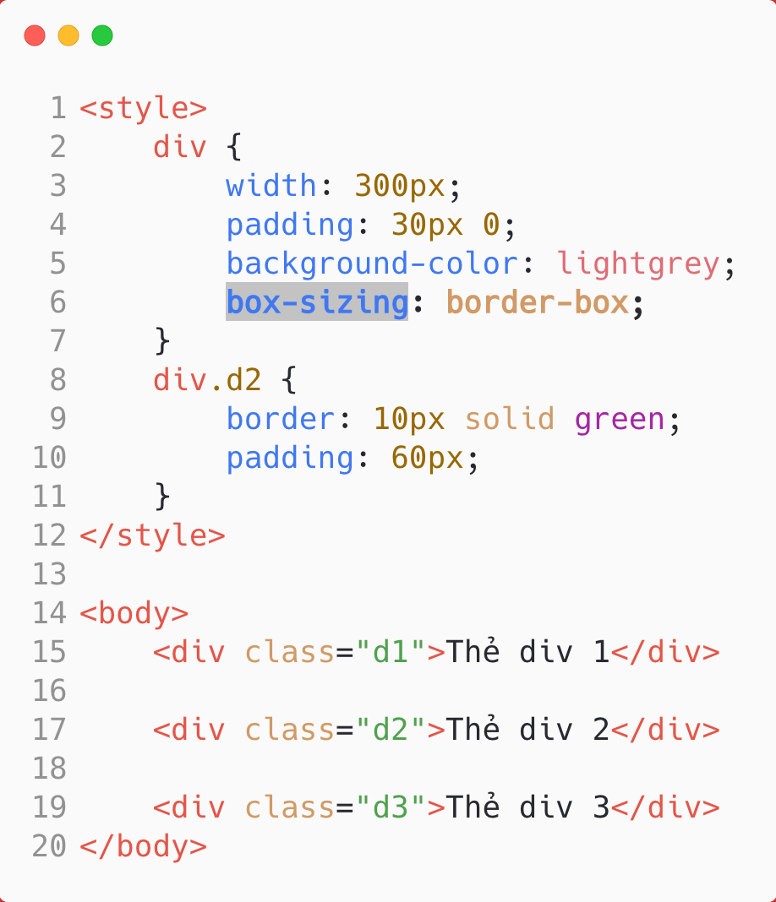

Slide 30
FLOATING

Slide 31
CSS Float
The CSS float property specifies how an element should float.
The CSS clear property specifies what elements can float beside the cleared element and on which side.

Slide 32
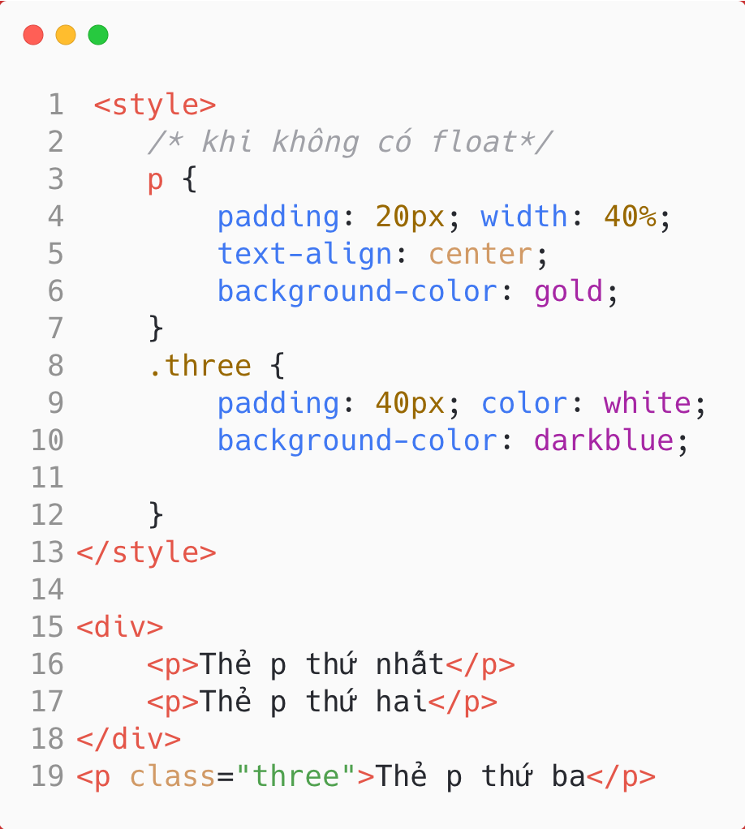
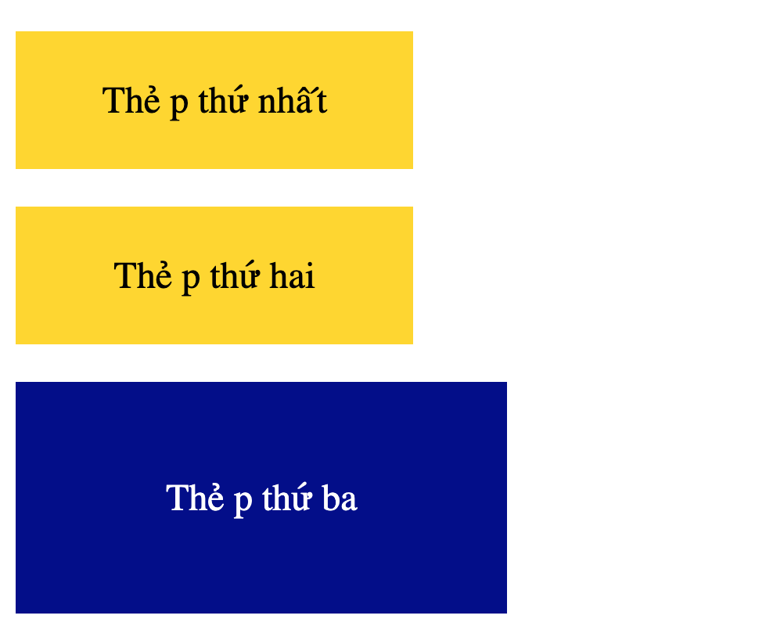
Without floating

Slide 33
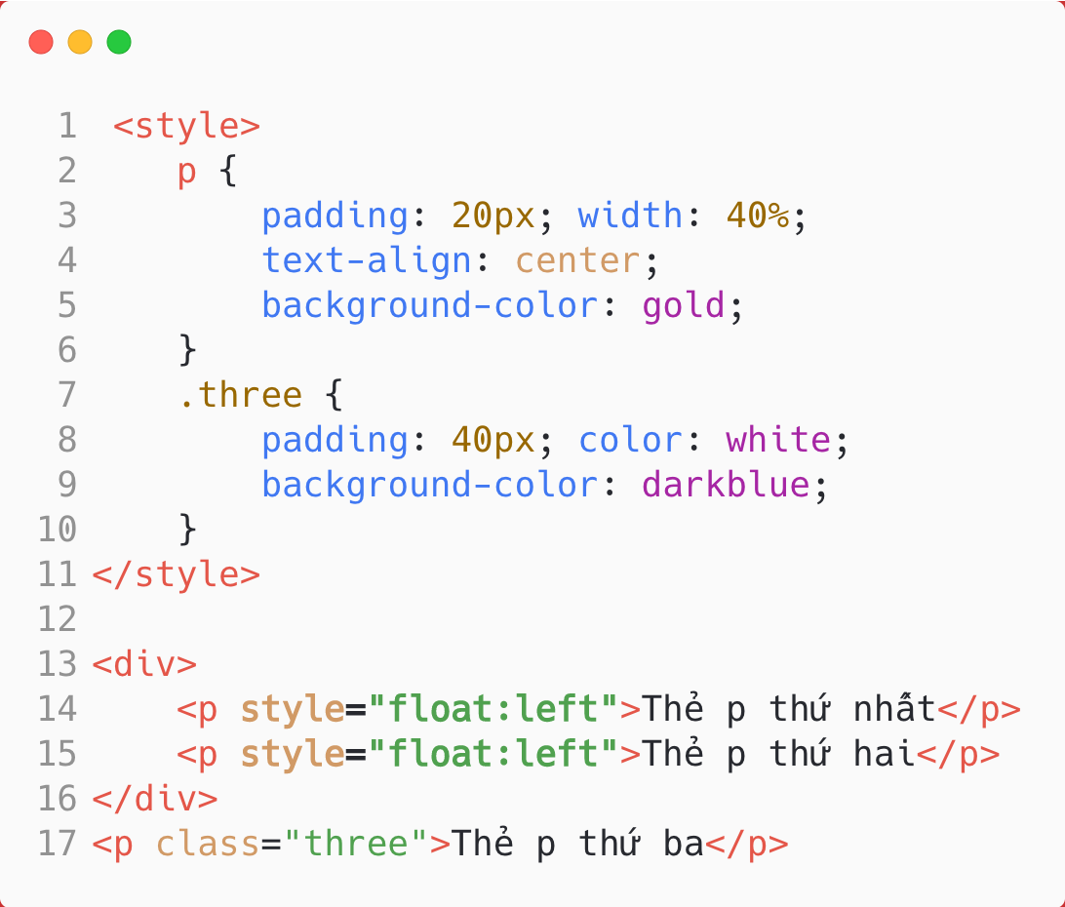
With float

Slide 34
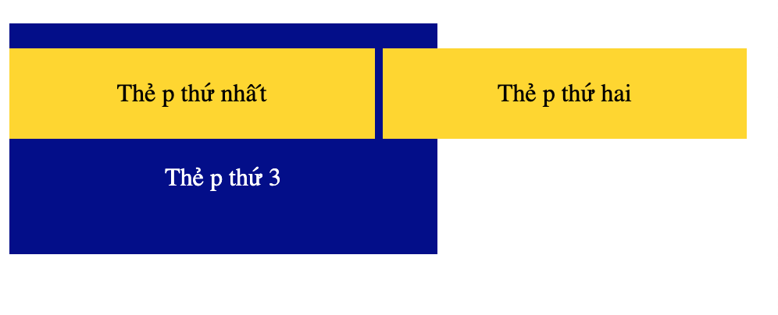
With float

Slide 35
THE CLEAR PROPERTY

Slide 36
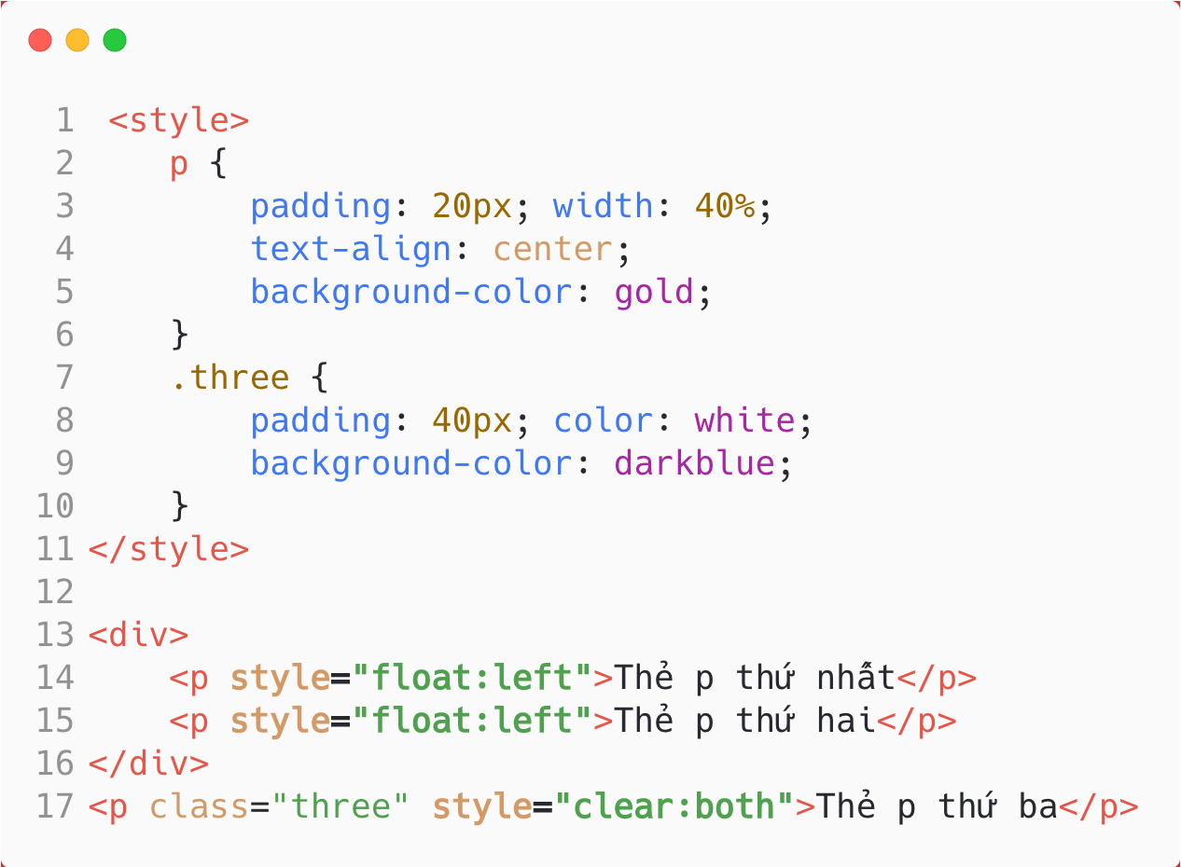

Slide 37
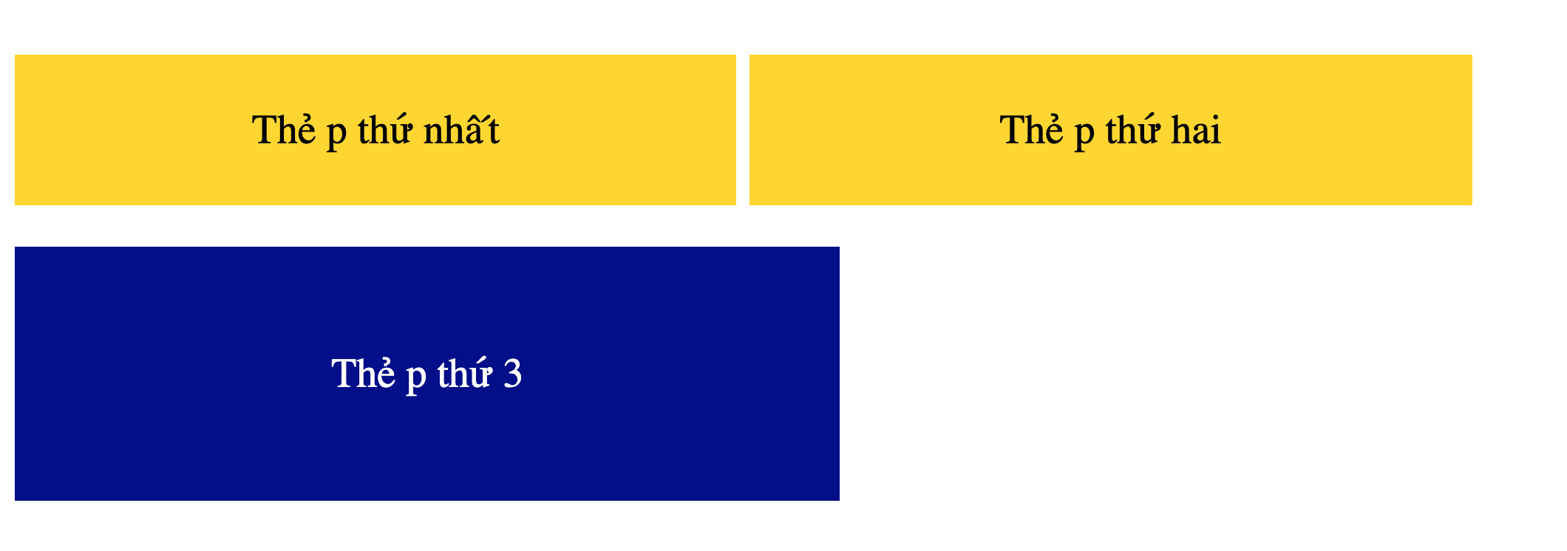

Slide 38
Responsive Web Design

Slide 39
Responsive Web Design
Responsive web design makes your web page look good on all devices.
Responsive web design uses only HTML and CSS.
Responsive web design is not a program or a JavaScript.

Slide 40
Viewport
The viewport is the user's visible area of a web page.
The viewport varies with the device, and will be smaller on a mobile phone than on a computer screen.
Before tablets and mobile phones, web pages were designed only for computer screens, and it was common for web pages to have a static design and a fixed size.
Then, when we started surfing the internet using tablets and mobile phones, fixed size web pages were too large to fit the viewport. To fix this, browsers on those devices scaled down the entire web page to fit the screen.

Slide 41
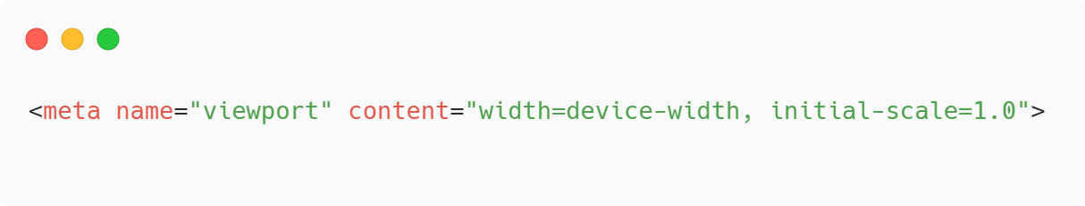
Setting the Viewport
The width=device-width part sets the width of the page to follow the screen-width of the device (which will vary depending on the device).
The initial-scale=1.0 part sets the initial zoom level when the page is first loaded by the browser.

Slide 42
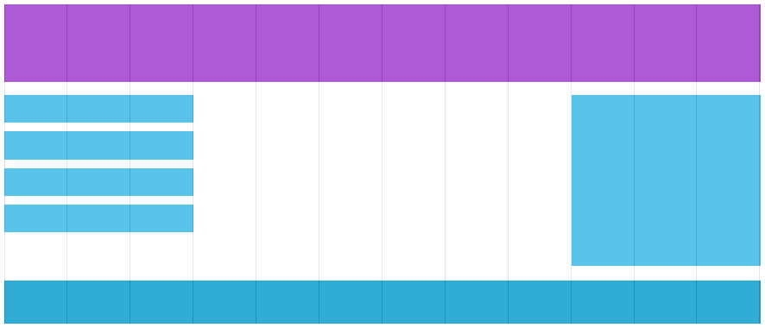
Gridview
Many web pages are based on a grid-view, which means that the page is divided into columns.

Slide 43
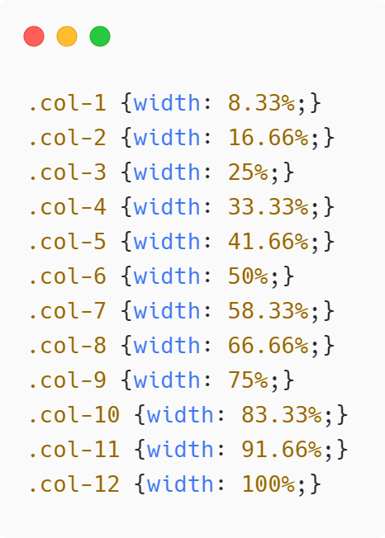
Gridview
A responsive grid-view often has 12 columns, and has a total width of 100%, and will shrink and expand as you resize the browser window.

